Slide 1
ETHICS IN ENGINEERING
Lecture 1/4

Slide 2

WHAT IS MEANT BY ETHICS?
http://manofthehouse.com/money/career-advice/business-ethics-in-the-workplace

Slide 3

System of moral principles
  Principles of right and wrong
Principles of conduct governing behavior of an individual or a group
http://www.yourdictionary.com/library/reference/define-ethics.html

Slide 4
CLICKER QUESTION
A person’s behavior is always ethical when one:
Does what is best for oneself
Has good intentions, no matter how things turn out
Does what is best for everyone
Does what is legal

Slide 5

ETHICS IN AN ENGINEERING COURSE????
We have been studying engineering, such as design, analysis, and performance measurement.
Where does ethics fit in?
http://www.free-clep-prep.com/Business-Ethics-and-Society-DSST.html

Slide 6
HOW ETHICS FITS INTO ENGINEERING
Engineers . . .
  Build products such as cell phones, home appliances, heart valves, bridges, & cars. In general they advance society by building new technology.
  Develop processes, such as the process to convert salt water into fresh water or the process to recycle bottles. These processes change how we live and what we can accomplish.

Slide 7
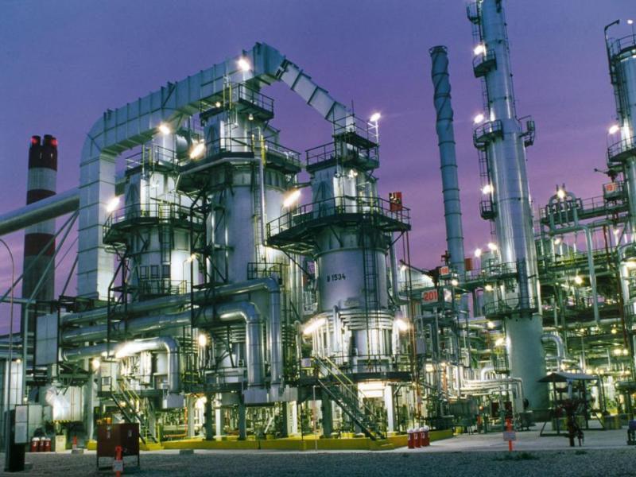
PRODUCTS AND PROCESSES HAVE CONSEQUENCES FOR SOCIETY:
If the bridge has an inadequate support, it will fail.
If the gas tank is positioned too close to the bumper, it might explode from a small accident.
If a medical instrument isn’t accurate, improper doses of medication can be given.
If the process for refining gas produces too much toxins, it harms the local community.

Slide 8
Decisions made by engineers usually have serious consequences to people -- often to multitudes of people.
Ethics and ethical reasoning guide decision-making.

Slide 9
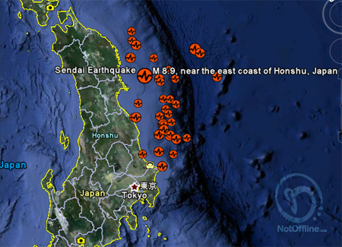
Consider the March 11, 2011 8.9 magnitude earthquake near Sendai, Japan.

Slide 10
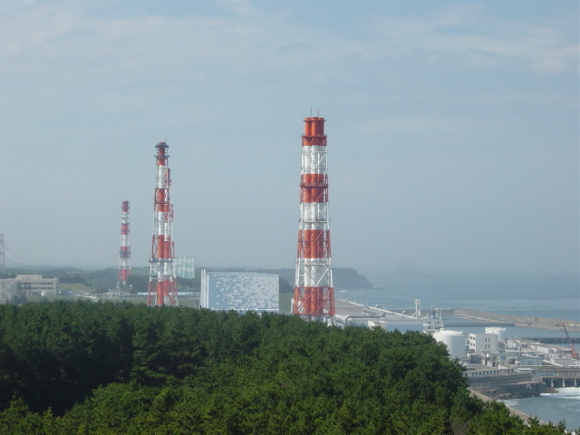
The damage to the Fukushima I Nuclear Power Plant (Fukushima Dai-ichi)
has led people worldwide to rethink the ethics of nuclear power.

Slide 11
Notice the issues that come up in these discussions:
ISSUE #1: HEALTH AND SAFETY
RISKS: Danger to current and future
generations from leakage of radio-
isotopes used in nuclear power.
Plutonium-239 (half-life = 24,110 yrs) is a particularly toxic radio-isotope.
Normally, 10 half lives are required before a Pu-239 contaminated area is considered safe again, in the case of plutonium, roughly 250,000 years.
So if Pu leaked, -- say, due to an
earthquake -- it would cause a
health risk for roughly 8000
generations!!

Slide 12
Issues (cont.):
ISSUE #1: HEALTH AND SAFETY RISKS, FURTHER CONSIDERATIONS:
a) The possibility of medical science discovering a cure for cancer sometime in the current or next centuries adds uncertainty to the long-term health risks of leakages of radio-active isotopes.

Slide 13
Issues (cont.):
ISSUE #1: HEALTH AND SAFETY RISKS, FURTHER CONSIDERATIONS:
b) The use of nuclear power may increase our knowledge of radioisotopes used for medical purposes (possible benefit?).

Slide 14

Issues that come up in these discussions:
CONSEQUENCES OF
ALTERNATIVES TO NUCLEAR
POWER.
ISSUE #2: DEPLETION OF RESOURCES:
Fossil fuels, oil, natural gas and coal, are non-renewable. These resources also affect the goal of health because of their impact on pollution and climate changes.

Slide 15
Issues that come up in these discussions:
CONSEQUENCES OF
ALTERNATIVES TO NUCLEAR
POWER.
ISSUE #3: COMPARATIVE ECONOMIC COSTS OF RENEWABLE SOURCES.
Renewable sources such as hydro-electric-power, wind power, solar power, geo-thermal heat, agricultural biomass and tides do not cause the environmental hazards that fossil-fuels do.
But renewable sources must be balanced with the amount of energy needed to produce and maintain them and consequent environmental hazards. Currently, for example, the energy required to manufacture and install solar energy systems comes from fossil fuels.

Slide 16
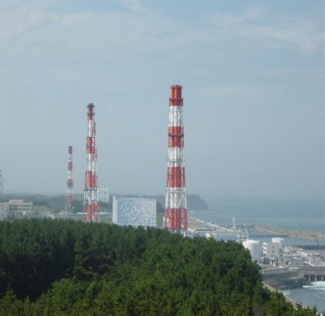
REASONING
The kind of reasoning that goes on in such discussions involves certain goals
such as, in this case, health, safety and biodiversity.
The reasoning then focuses on finding the best – or at least the reasonably better --
means
for obtaining those goals.

Slide 17
This type of reasoning is often called practical reasoning.
It uses different methods from mathematics and the sciences.
Ethical reasoning is a type of practical reasoning that concerns certain societal or life-form goals, such as justice, equality, freedom, health and safety.

Slide 18
THE ESSENCE OF YOUR ENGINEERING CAREER
Engineering is one of the most important professions in society.
As engineers we don’t just build things and develop processes.
We build things and make processes in order to better society.
In order to make society better we have to reflect constantly on the products and processes that we make.

Slide 19
SOCIAL RESPONSIBILITY
One main connection between ethics and engineering comes from the impact that engineered products and processes have on society.
Engineers have to think about designing, building, and marketing products that benefit society.
Social Responsibility requires taking into consideration the needs of society.

Slide 20
TYPICAL ETHICAL ISSUES THAT ENGINEERS ENCOUNTER
Safety
Acceptable risk
Compliance
Confidentiality
Environmental health
Data integrity
Conflict of interest
Honesty/Dishonesty
Societal impact
Fairness
Accounting for uncertainty, etc.

Slide 21
PROFESSIONAL RESPONSIBILITY
Ethics has a second connection with engineering.
It comes from the way in which being socially responsible puts duties and obligations on us individually.
Ethics fits into engineering is through professional responsibility.

Slide 22
TWO DIMENSIONS OF ETHICS IN ENGINEERING
Ethics is part of engineering for two main reasons.
Engineers need to be socially responsible when building products and processes for society.
Social responsibility requires professional responsibility.

Slide 23
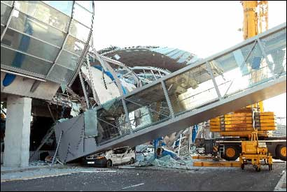
ABET SAYS . . .
By the time of graduation students will have an understanding of professional and ethical responsibility
http://www.boston.com/news/globe/magazine/articles/2006/09/10/its_the_engineering_stupid/

Slide 24
WHAT WE WILL DISCUSS
The code of ethics for engineers.
Practicing ethics as an engineering student.
How to identify and analyze ethical dilemmas through case analysis.
Specific examples of ethical situations you may encounter.

Slide 25

Part 1: The Code of Ethics for Engineers
http://www.nspe.org/Ethics/CodeofEthics/index.html

Slide 26
ROLE-RESPONSIBILITIES
We need to make a distinction between two ways in which ethics can apply to one’s life.
The two ways ethical issues can apply to one’s life are based on role responsibilities. Role responsibilities are responsibilities that attach to us in virtue of a role that we have. Each of us has different roles that we play in our life.
  Engineering Student
  Friend
  Citizen
  Employee

Slide 27
Role | Responsibilities
Friend | Look out for the interests of your friend.
Athlete | Play your sport in a professional manner.
Employee | Perform the duties of your job.
Parent | Look after your children and their interests
Citizen | Follow the laws of the country in which you live.

Slide 28
ETHICS IN ENGINEERING
There are many fields of engineering, such as
  Civil
  Mechanical
  Electrical
  Software
  Industrial
However, there are many ethical issues that arise across all of these fields of engineering.
The code of ethics for engineers pertains to engineers of all kinds.

Slide 29
CLICKER QUESTION
Engineers should follow their professional code of ethics because:
The public will trust engineers more if they know engineers have a code of ethics.
It helps them avoid legal problems, such as getting sued.
It provides a clear definition of what the public has a right to expect from responsible engineers.
It raises the image of the profession and hence gets engineers more pay.

Slide 30
THE ENGINEERING CODE OF ETHICS
The Engineering Code of Ethics has three components:
The Fundamental Canons: which articulate the basic components of ethical engineering.
The Rules of Practice: which clarify and specify in detail the fundamental canons of ethics in engineering.
Professional Obligations: which elaborate the obligations that engineers have.

Slide 31
NSPE FUNDAMENTAL CANONS OF ETHICS
Engineers in the fulfillment of their professional duties shall:
Hold paramount the safety, health, and welfare of the public.
Perform services only in areas of their competence.
Issue public statements only in an objective and truthful manner.
Act for each employer or client as faithful agents or trustees.
Avoid deceptive acts.
Conduct themselves honorably, responsibly, ethically, and lawfully, so as to enhance the honor, reputation, and usefulness of the profession.

Slide 32
TRY IT YOURSELF
You are supervising a product with specifications that only U.S.-made parts may be used.
Late in the project you discover a sub-contractor has supplied a part with foreign-made bolts.
They aren’t very noticeable and would function identically to U.S.-made bolts.
Your customer urgently needs the finished product.
What should you do?

Slide 33
CLICKER QUESTION
Should you:
Say nothing and deliver the product with the foreign bolts because the customer won’t notice.
Find some roughly equivalent violation of the contract/specs for which the customer is responsible and tell them you will ignore their violation if they ignore yours.
Tell the customer about the problem, and let them decide what you should do next.
Find loopholes in the original specifications so that your company hasn’t legally violated the specs.

Slide 34
C (tell the customer) is the correct answer because it lets the customer decide what is in their best interest given new information.
This may be tough, because your job may be on the line and your company’s reputation may be at stake.
Avoid deceptive acts
Act for each employer or client as faithful agents or trustees

Slide 35
IMPORTANT NOTES ABOUT THE CODE OF ETHICS
It is not a legally binding document.
It is not something that we want (or need) engineers to memorize.
It is something we want engineers to understand and be able to live by as engineers.
However, in the beginning knowing the code is a guide to understanding how to apply it.

Slide 36
REVIEW THE LAROM CASE
Hired at Larom because of the promising research with catalysts as a student at SJSU.
Supervisor, Alex Smith, announces that your unit must make a recommendation within next two days on which catalyst should be used in processing a major product.
The overwhelming consensus of the engineers in your unit, based on many years of experience, is that catalyst A is best for the job.
Your research provides preliminary evidence that catalyst B might be more reliable, more efficient, and considerably less costly.

Slide 37
REVIEW THE LAROM CASE
You ask if the recommendation can be delayed a month to see if firmer evidence can be found.
Alex asks you to write up the report, leaving out the preliminary data about catalyst B.
He says, “we've already taken too much time on this project. … we have to be decisive--and we have to look decisive …Besides, we've had a lot of experience in this area."
You have no desire to challenge your colleagues. You don't necessarily disagree with them about which catalyst is best. BUT you wish you had been given more time to work on catalyst B and feel uncomfortable about leaving the preliminary data out of the report.

Slide 38
WHAT RECOMMENDATION DID YOU MAKE
Discuss this with a group
Identify the issues
Compare courses of action
Identify best course of action
One of you may be asked to report out

Slide 39
ETHICS TAKES PRACTICE
KNOWLEDGE VS. BEHAVIOR
Unlike robots, no one can just program you to be an ethical engineer that follows the codes.
It is possible to know the codes of ethics for engineering (or being a student), yet fail to follow them.
Ethical behavior is about practice and virtue. It is about going beyond the codes, and practicing behavior that leads to an ethical life.

Slide 40
THE EXAMPLE OF INTEGRITY
A building has structural integrity when it is designed in way such that it appropriately responds to the stresses and loads that it is designed to act under.
Just as a building can have poor integrity or good integrity. A person can also.
A person has integrity when she/he can follow the codes he/she is supposed to follow under the stresses and loads of his/her role.

Slide 41
CLICKER QUESTION
Which of the following ensure that behavior is ethical?
Following the law
Acting in the best interest of society
Following non-legal standards for socially appropriate conduct
All of the above
II and III only
None of the above
I only

Slide 42
LAW VS. MORALITY:
DON’T CONFUSE THE TWO
Legal & Moral | Legal & Immoral
Illegal & Moral | Illegal & Immoral

Slide 43
EXAMPLES OF THE CATEGORIES
Legal & Moral | Designing a system to be safe.
Legal & Immoral | Owning a slave pre-civil war in the US.
Illegal & Moral | Parking in a no parking zone, to come to the aid of an injured person
Illegal & Immoral | Killing an innocent person.

Slide 44

Part 2: Practicing ethics as an engineering student

Slide 45
STUDENTS HAVE A CODE OF ETHICS TOO
Senate Policy S07-2 (http://www.sjsu.edu/senate/S07-2.htm)
The San José State University Academic Integrity Policy requires that each student:
  1. Know the rules that preserve academic integrity and abide by them at all times. This includes learning and abiding by rules associated with specific classes, exams and course assignments.
  2. Know the consequences of violating the Academic Integrity Policy.
  3. Know the appeal rights, and the procedures to be followed in the event of an appeal.
  4. Foster academic integrity among peers.

Slide 46
S07-2 PREAMBLE
The University emphasizes responsible citizenship and an awareness of ethical choices inherent in human development.
Academic honesty and fairness foster ethical standards for all those who depend upon the integrity of the university, its courses, and its degrees.
University degrees are compromised and the public is defrauded if faculty members or students knowingly or unwittingly allow dishonest acts to be rewarded academically.

Slide 47
PLAGIARISM & CHEATING
Many components go into being a good engineering student.
One of the most important, as reflected by the codes of ethics for engineers, is to be competent in your field of engineering.
To be competent, it is necessary that one actually knows what they claim to know.
Proving to others that you know what you are supposed to know requires certification through a degree.

Slide 48
WHAT STUDENTS SAY
70% of American high school seniors admit to cheating on at least one test
95% of the students who said they cheated were never caught.
An average of 75% of college students report cheating sometime during their college career
Notes:
Cheating in Online Student Assessment: Beyond Plagiarism, Neil C. Rowe 2004

Slide 49
ACADEMIC DISHONESTY
Cheating
At SJSU, cheating is the act of obtaining or attempting to obtain credit for academic work through the use of any dishonest, deceptive, or fraudulent means.
SJSU defines 5 basic types of cheating

Slide 50
CHEATING IS WRONG?
Cheating also undermines the work of fellow students who are honest.
When you cheat, all the other students who didn’t cheat are penalized. They end up getting lower grades. As a consequence of lower grades they lose out on scholarships and recommendations.

Slide 51
CHEATING VS. TEAMWORK
Working on a team for an assigned project is not cheating.
However, failing do due your assigned task on an a team project is a form of cheating. It is called free-riding, which is benefiting from the work of others without doing any work of your own.
Teamwork is important in engineering, but free-riding is wrong, since if everyone did it nothing would get done.

Slide 52
COPYING
One obvious type of cheating that we all recognize is copying someone’s work on a homework assignment, exam, or paper.
Submitting someone’s work as your own is a kind of cheating.

Slide 53
MULTIPLE SUBMISSIONS
Submitting your own work from one class to another class or submitting one piece of work to two distinct classes is a kind of cheating.
A paper for one class is not a paper for another class.

Slide 54
UNAUTHORIZED SOURCES
Using sources that one is not allowed to use as deemed by the instructor or the university as a whole is a kind of cheating, such as solution manuals.
Also a text message from your friend with the answer to a question on the exam is a form of cheating.

Slide 55
ALTERING GRADES
Altering your grade in any way is a form of cheating.
If you are given a C on your homework, paper, or exam and then you change your grade to a B+, you have cheated.

Slide 56
SURROGATE
Surrogate cheating occurs when someone else either does your homework, takes an exam for you, or writes your paper.
Doing someone’s work for them is a kind of cheating.

Slide 57
WHY IS CHEATING WRONG?
Cheating undermines the credibility of the university and the degrees it awards.
If too many people cheat at SJSU, then the degrees awarded by SJSU won’t certify that its students are competent. So, by cheating you not only hurt yourself, you also hurt others.

Slide 58
ETHICS – COURAGE & INTEGRITY
As we will be seeing more and more being ethical requires:
  Courage to do the right thing the situation calls for.
  &
  The integrity to withstand the pressures that push you in the wrong direction.

